Slide 1

Microeconomics
Eighth Edition
Chapter 6
Elasticity: The Responsiveness of Demand and Supply
Copyright © 2021, 2019, 2017 Pearson Education, Inc. All Rights Reserved
Notes:
If this PowerPoint presentation contains mathematical equations, you may need to check that your computer has the following installed:
1) MathType Plugin
2) Math Player (free versions available)
3) NVDA Reader (free versions available)

Slide 2
Chapter Outline
6.1 The Price Elasticity of Demand and Its Measurement
6.2 The Determinants of the Price Elasticity of Demand
6.3 The Relationship between Price Elasticity of Demand and Total Revenue
6.4 Other Demand Elasticities
6.5 Using Elasticity to Analyze the Disappearing Family Farm
6.6 Price Elasticity of Supply and Its Measurement

Slide 3

Do Soda Taxes Work?
Recently a number of cities have enacted taxes on soda and other sweetened beverages. Why?
To reduce sugar consumption, and hence obesity and diabetes
To raise funds for public projects
Interestingly, these goals partially conflict: if beverage consumption decreases as intended, then less tax revenue will be collected.
How can we know what the actual outcome will be?

Slide 4
6.1 The Price Elasticity of Demand and Its Measurement
Define and calculate price elasticity of demand.
As the price of sweetened beverages increase, we expect people will buy fewer of them. But how many fewer?
How can we come up with a sensible way to measure how much quantity changes when price changes?
One idea is to look at the slope of the demand curve.
But this won’t work, since the value of the slope depends on the units used to measure on the axes.
Instead, we define an elasticity, a measure of how much one economic variable response to changes in another economic variable, based on percentage changes in the variables.

Slide 5
Price Elasticity of Demand
Our first elasticity to examine is the price elasticity of demand, the responsiveness of the quantity demanded to a change in price:
Although the slope and price elasticity of demand are related, they are not the same thing.
Since price and quantity change in opposite directions on the demand curve, the price elasticity of demand is a negative number.
However we often refer to “more negative” elasticities as being “larger” or “higher”.

Slide 6
Price Elasticity of Demand Terminology
A “large” value for the price elasticity of demand means that quantity demanded changes a lot in response to a price change.
Formally, we say demand is elastic if its price elasticity of demand is larger (in absolute value) than 1.
So a 10 percent increase in price would result in a greater than 10 percent decrease in quantity demanded.
Demand is inelastic if its price elasticity of demand is smaller (in absolute value) than 1.
That is, close to zero, indicating that quantity demanded changes little in response to a price change.
Demand is unit-elastic if the price elasticity of demand is exactly equal to 1.

Slide 7
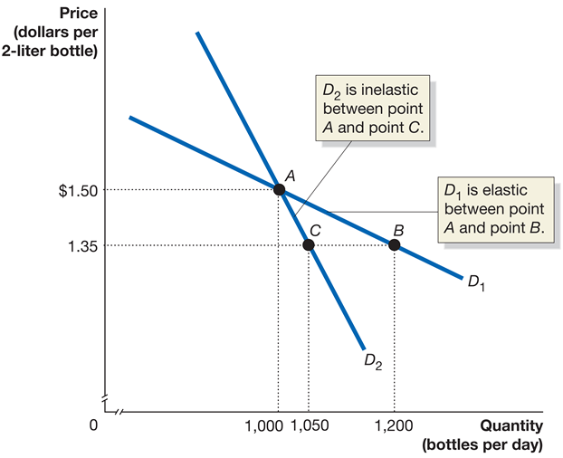
Figure 6.1 Elastic and Inelastic Demand
Along D₁, cutting the price from $1.50 to $1.35 increases the number of bottles sold from 1,000 per day to 1,200 per day; demand is elastic between point A and point B.
Along D₂, cutting the price from $1.50 to $1.35 increases the number of bottles sold from 1,000 per day only to 1,050 per day; demand is inelastic between point A and point C.
Notes:
Along D1, cutting the price from $4.00 to $3.70 increases the number of gallons demanded from 1,000 to 1,200 per day. Because the percentage change in quantity demanded is greater than the percentage change in price (in absolute value), demand is elastic between point A and point B. Along D2, cutting the price from $4.00 to $3.70 increases the number of gallons demanded only from 1,000 to 1,050 per day. Because the percentage change in quantity demanded is smaller than the percentage change in price (in absolute value), demand is inelastic between point A and point C.
On the truncated graph, X axis represents quantity in bottles per day, and the Y axis represents price in dollars per 2 liter bottle. Demand line D sub 1 is elastic between points A and B. Point A is at (1,000, 1.50), and B at (1,200, 1.35). Demand line D sub 2 intersects D sub 1 at point A, and is inelastic between points A and C. D sub 2 passes through point C at (1,000, 1.35).

Slide 8
Percentage Changes and the Midpoint Formula
Percentage changes have the unfortunate property that the percentage change from A to B is not the negative of the percentage change from B to A.
Example: On the previous slide, from point A to point B, quantity increased from 1,000 to 1,200, an increase of 20 percent.
However from B to A, quantity decreases by 16.7 percent.
This would mean the elasticity from A to B was different from the elasticity from B to A, and undesirable property.
To avoid this, we use the midpoint formula for percentage changes:

Slide 9
The Midpoint Formula for Elasticity
The midpoint formula avoids the confusion of whether we are going from A to B or from B to A: we use the average of A and B in the denominator instead of choosing one of them.
Price elasticity of demand becomes:
This first term is the percentage change in quantity, using the midpoint formula.
The second term is the percentage change in price, using the midpoint formula.

Slide 10

Calculating Price Elasticity of Demand (1 of 3)
At your grocery store, you cut the price of Coca-Cola from $1.50 per bottle to $1.30 per bottle. Coca-Cola sales went up from 2,000 to 2,500 gallons per day, as on demand curve D₁.
To calculate this price elasticity, we first need the average quantity and price:
Notes:
On the truncated graph, X axis represents quantity in bottles per day, and the Y axis represents price in dollars per 2 liter bottle. Demand line D sub 1 is elastic between points A and B. Point A is at (2,000, 1.50), and B at (2.500, 1.30). Demand line D sub 2 intersects D sub 1 at point A, and is inelastic between points A and C. D sub 2 passes through point C at (2,100, 1.30).

Slide 11
Calculating Price Elasticity of Demand (2 of 3)
Now calculate the percentage change in quantity and price:
Then price elasticity of demand is the ratio of these two:
This is greater in absolute value than −1, So we say that demand in this range is price elastic.
Notes:
On the truncated graph, X axis represents quantity in bottles per day, and the Y axis represents price in dollars per 2 liter bottle. Demand line D sub 1 is elastic between points A and B. Point A is at (2,000, 1.50), and B at (2.500, 1.30). Demand line D sub 2 intersects D sub 1 at point A, and is inelastic between points A and C. D sub 2 passes through point C at (2,100, 1.30).

Slide 12
Calculating Price Elasticity of Demand (3 of 3)
What if quantity had only increased to 2,100 as in demand curve D₂?
Percentage change in price remains the same (−14.3%); however
So price elasticity of demand is now:
This is smaller (in absolute value) than −1, so demand is inelastic.
Notes:
On the truncated graph, X axis represents quantity in bottles per day, and the Y axis represents price in dollars per 2 liter bottle. Demand line D sub 1 is elastic between points A and B. Point A is at (2,000, 1.50), and B at (2.500, 1.30). Demand line D sub 2 intersects D sub 1 at point A, and is inelastic between points A and C. D sub 2 passes through point C at (2,100, 1.30).

Slide 13
Observations About Elasticity (1 of 2)
While slope and elasticity are not the same, they are related:
If two demand curves go through the same point, the one with the higher slope also has the higher (more negative) elasticity.
A vertical demand curve means that quantity demanded does not change as price changes.
So elasticity is zero.
A vertical demand curve is perfectly inelastic.
Perfectly inelastic demand: The case where the quantity demanded is completely unresponsive to price and the price elasticity of demand equals zero.

Slide 14
Observations About Elasticity (2 of 2)
A horizontal demand curve means quantity demanded is infinitely responsive to price changes.
Elasticity is infinite.
A horizontal demand curve is perfectly elastic.
Perfectly elastic demand: The case where the quantity demanded is infinitely responsive to price and the price elasticity of demand equals infinity.
Another special case occurs when a decrease in price results in the same percentage increase in quantity demanded; in this case we say demand is unit elastic.

Slide 15
Table 6.1 Summary of the Price Elasticity of Demand (1 of 5)
Notes:
If demand is elastic, then the absolute value of price elasticity is greater than 1. Price versus quantity is graphed. A demand line starts at (5, 2) and falls diagonally to the right to (1500, 0.5). It passes through the points (1000, 1.5) and (1200, 1.35). An arrow extends down from y= 1.5 to y = 1.35. An inset text box reads, 1, an 11 percent cut in price. An arrow extends to the right from x = 1000 to x = 1200. An inset text box reads, 2, causes an 18 percent increase in quantity demanded.

Slide 16
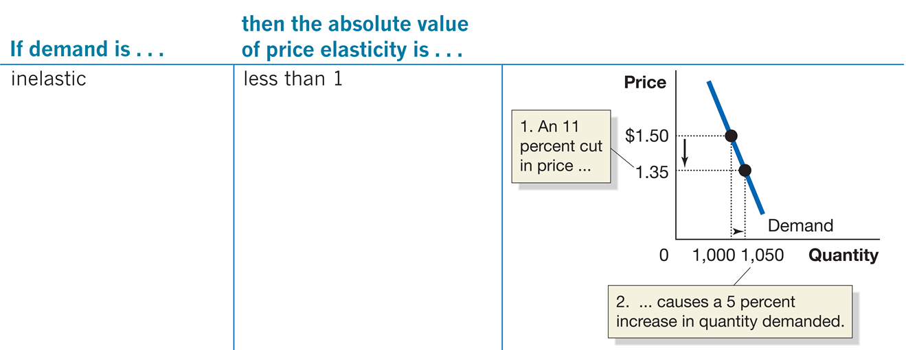
Table 6.1 Summary of the Price Elasticity of Demand (2 of 5)
Notes:
If demand is inelastic, then the absolute value of price elasticity is less than 1. Price versus quantity is plotted. A demand line starts at (500, 2) and falls diagonally to the right to (1100, 0.3). It passes through the points (1000, 1.5) and (1050, 1.35). An arrow extends from from y = 1.5 to y = 1.35. An inset text box reads, 1, an 11 percent cut in price. An arrow extends from x = 1000 to x = 1050. An inset text box reads, 2, causes a 5 percent increase in quantity demanded.

Slide 17
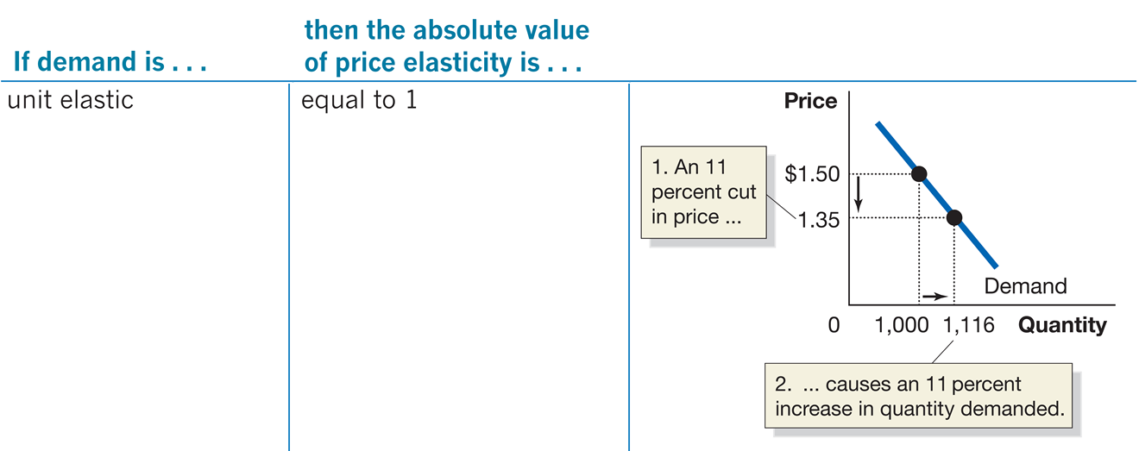
Table 6.1 Summary of the Price Elasticity of Demand (3 of 5)
Notes:
If demand is unit elastic, then the absolute value of price elasticity is equal to 1. Price versus quantity is plotted. The demand line starts at (500, 2) and falls diagonally to the right to (1200, 0.4). It passes through the points (1000, 1.5) and (1116, 1.35). An arrow extends down from y = 1.5 to y = 1.35. A text inset reads, 1, An 11 percent cut in price. An arrow extends from x = 1000 to x = 1116. A text inset reads, 2, causes an 11 percent increase in quantity demanded.

Slide 18
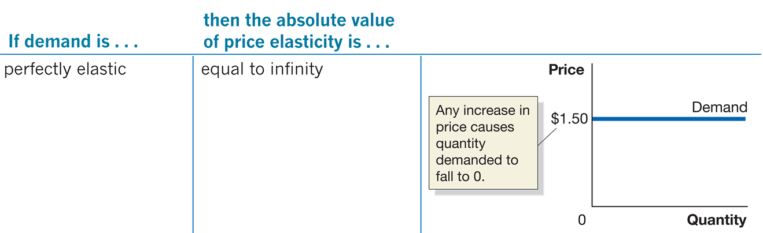
Table 6.1 Summary of the Price Elasticity of Demand (4 of 5)
Notes:
If demand is perfectly elastic, then the absolute value of price elasticity is equal to infinity. Price versus quantity is plotted. A horizontal line at y = 1.50 dollars is the demand curve. A text inset reads, any increase in price causes quantity demanded to fall to 0.

Slide 19
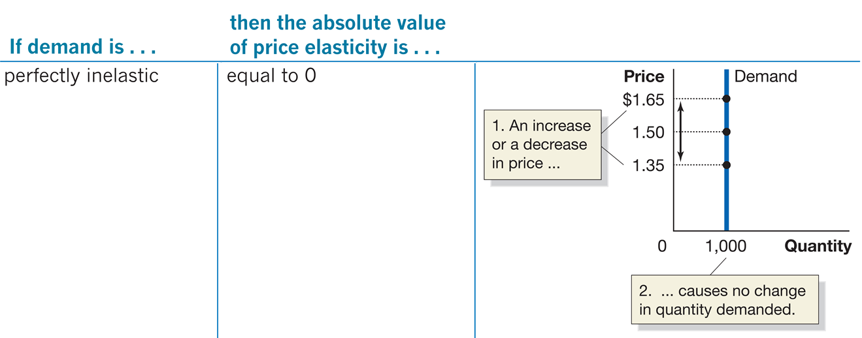
Table 6.1 Summary of the Price Elasticity of Demand (5 of 5)
Notes:
If demand is perfectly inelastic, then the absolute value of price elasticity is equal to 0. Price versus quantity is plotted.The demand curve is a vertical line at x = 1000. The line has points at y= 1.35, 1.5, and 1.65. A double sided arrow at y= 1.5 points up to 1.65, and down to 1.35. A text inset reads, 1, an increase or a decrease in price. A second inset by x = 1000 reads, 2, causes no change in quantity demanded.

Slide 20
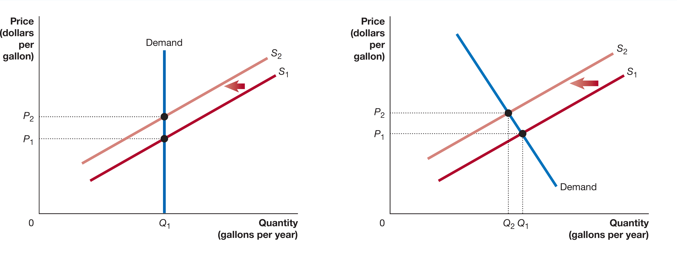
Don’t Confuse “Inelastic” with “Perfectly Inelastic”
For example, gasoline demand is inelastic; the quantity demanded does not change much as the price of gasoline changes.
It is not perfectly inelastic; it is somewhat responsive to price.
Which panel shows this?
Notes:
On both graphs, the X axis represents quantity in gallons per year, and the Y axis represents price in dollars per gallon. On graph 1, Supply line S sub 1 shifts left and becomes S sub 2. The demand line is vertical, and intersects S sub 2 at (Q sub 1, P sub 2), and S sub 1 at (Q sub 1, P sub 1). On graph 2, supply line S sub 1 shifts left and becomes S sub 2. The demand line falls through the graph, intersecting S sub 2 at (Q sub 1, P sub 2), and S sub 1 (Q sub 1, P sub 1).

Slide 21
6.2 The Determinants of the Price Elasticity of Demand
List and explain the determinants of the price elasticity of demand.
Why do some goods have a high price elasticity of demand, while others have a low price elasticity of demand?
There are several characteristics of the good, of the market, etc. that determine this.
The availability of close substitutes
If a product has more substitutes available, it will have more elastic demand.
Example: There are few substitutes for gasoline, so its price elasticity of demand is low.
Example: There are many substitutes for Nikes (Reeboks, Adidas, etc.), so their price elasticity of demand is high.

Slide 22
More Determinants of the Price Elasticity of Demand
The passage of time
Over time, people can adjust their buying habits more easily. Elasticity is higher in the long run than the short run.
Example: If the price of gasoline rises, it takes a while for people to adjust their gasoline consumption. How might they do that?
Buying a more fuel-efficient car
Moving closer to work
Whether the good is a luxury or a necessity
People are more flexible with luxuries than necessities, so price elasticity of demand is higher for luxuries.
Example: Many people consider milk and bread necessities; they will buy them every week almost regardless of the price.

Slide 23
Still More Determinants of the Price Elasticity of Demand
The definition of the market
The more narrowly defined the market, the more substitutes are available, and hence the more elastic is demand.
Example: You might believe there is no good substitute for jeans, so your demand for jeans is very inelastic.
But if you consider different brands of jeans, you might be more sensitive to the price of a particular brand.
The share of a good in a consumer’s budget
If a good is a small portion of your budget, you will likely not be very sensitive to its price.
Example: You might buy table salt once a year or less; changes in its price will not affect very much how much you buy.

Slide 24
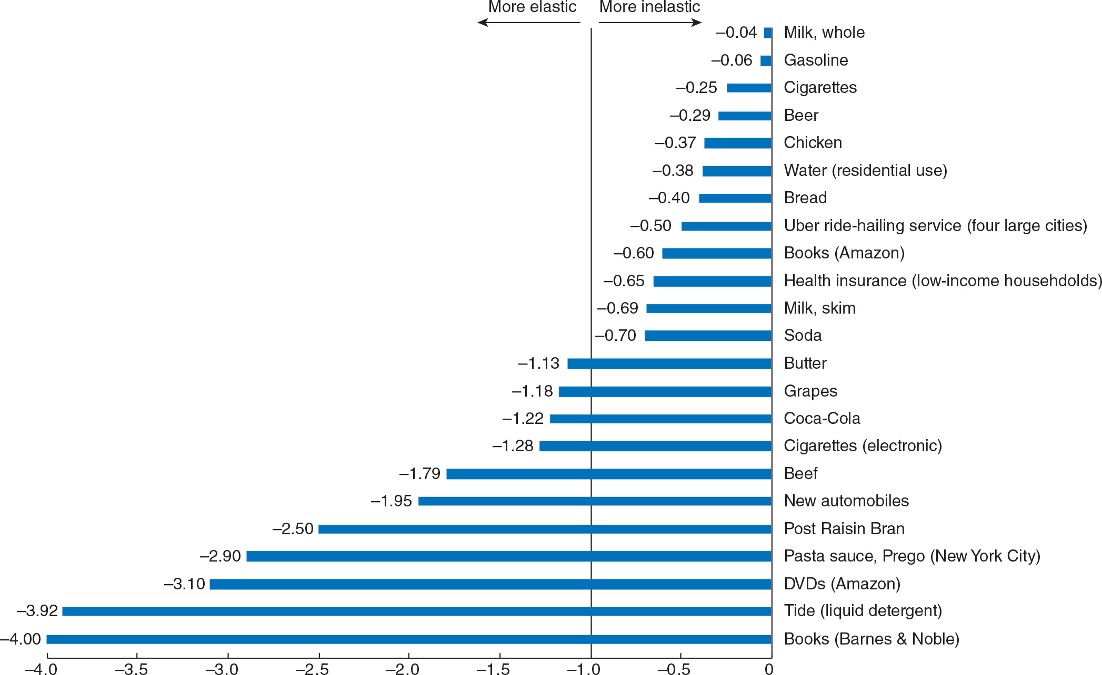
Figure 6.2 Estimated Real-World Price Elasticities of Demand
Notes:
On the X axis, all measurements left of negative 1.0 is more elastic, and to the right to the Y axis is more inelastic. Value of items are as follows.
A table has 22 rows and 2 columns. The columns have the following headings from left to right. Milk, whole, Negative 0.04. The row entries are as follows. Row 1. Milk, whole, Gasoline. Negative 0.04, Negative 0.06. Row 2. Milk, whole, Cigarettes. Negative 0.04, Negative 0.25. Row 3. Milk, whole, Beer. Negative 0.04, Negative 0.29. Row 4. Milk, whole, Chicken. Negative 0.04, Negative 0.37. Row 5. Milk, whole, Water, residential use. Negative 0.04, Negative 0.38. Row 6. Milk, whole, Bread. Negative 0.04, Negative 0.40. Row 7. Milk, whole, Uber ride hailing service, four large cities. Negative 0.04, Negative 0.50. Row 8. Milk, whole, Books, Amazon. Negative 0.04, Negative 0.60. Row 9. Milk, whole, Health insurance, low income households. Negative 0.04, Negative 0.65. Row 10. Milk, whole, Milk, skim. Negative 0.04, Negative 0.69. Row 11. Milk, whole, Soda. Negative 0.04, Negative 0.70. Row 12. Milk, whole, Butter. Negative 0.04, Negative 1.13. Row 13. Milk, whole, Grapes. Negative 0.04, Negative 1.18. Row 14. Milk, whole, Coca-Cola. Negative 0.04, Negative 1.22. Row 15. Milk, whole, Cigarettes, electronic. Negative 0.04, Negative 1.28. Row 16. Milk, whole, Beef. Negative 0.04, Negative 1.79. Row 17. Milk, whole, New automobiles. Negative 0.04, Negative 1.95. Row 18. Milk, whole, Post Rasin Bran. Negative 0.04, Negative 2.50. Row 19. Milk, whole, Pasta sauce, Prego, New York City. Negative 0.04, Negative 2.90. Row 20. Milk, whole, DVDs, Amazon. Negative 0.04, Negative 3.10. Row 21. Milk, whole, Tide, liquid detergent. Negative 0.04, Negative 3.92. Row 22. Milk, whole, Books, Barnes & Noble. Negative 0.04, Negative 4.00.

Slide 25
6.3 The Relationship Between Price Elasticity of Demand and Total Revenue
Explain the relationship between the price elasticity of demand and total revenue.
If you are a business owner, you need to decide how to price your product.
“How many customers will I gain if I cut my price?”
“What will happen to my total revenue if I cut my price?”
Knowing the price elasticity of demand for your product can help to answer these questions.
Total revenue: The total amount of funds a seller receives from selling a good or service, calculated by multiplying price per unit by the number of units sold.

Slide 26
Effect of Cutting Price with Different Elasticities
Suppose demand for your product is relatively price inelastic:
Customers are not very sensitive to the price of your product.
As you decrease the price, you expect to gain few additional customers.
The few additional customers do not compensate for the lost revenue, so overall revenue goes down.
Suppose demand for your product is relatively price elastic:
Customers are very sensitive to the price of your product.
As you decrease the price, you expect to gain many additional customers.
The many additional customers more than compensate for the lost revenue, so overall revenue goes up.

Slide 27
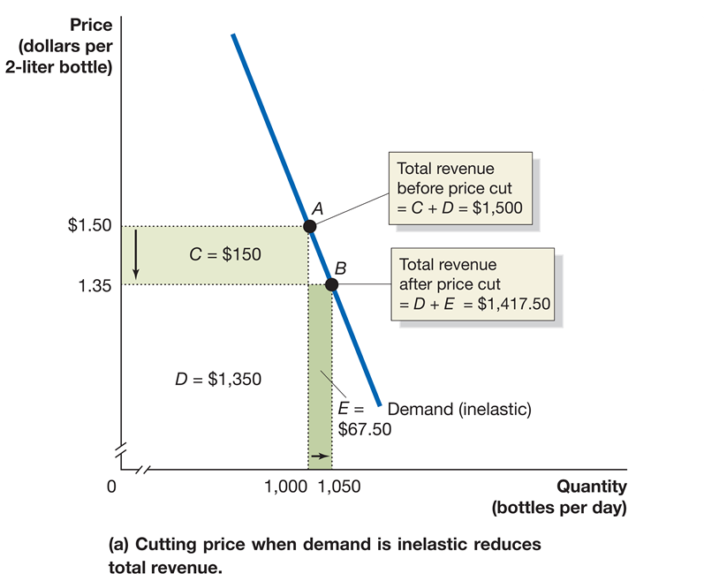
Figure 6.3 The Relationship Between Price Elasticity and Total Revenue (1 of 2)
Revenue before price cut (at A):
Revenue after price cut (at B):
The decrease in price does not generate enough extra customers (area E) to offset revenue loss (area C).
Notes:
On the truncated graphs, the X axis represents quantity in bottles per day, and the Y axis represents price in dollars per 2 liter bottles. Graph A represents cutting price when demand is inelastic reduces total revenue. The demand line is inelastic, and falls through points A and B. Point A (1,000, 1.50), is the total revenue before price cut = C + D = $1,500. Point B (1,050, 1.35), is the total revenue after price cut = D + E = $1,417.50. Left of the demand line, Part C = $150, and falls between (0, 1.35), (0, 1.50), (1,000, 1.50), and (1,000, 1.35), and shaded light green. Part D = $1,350, and falls between (0, 0), (0, 1.35), (1,000, 1.35), (1,000, 0). Part E = $67.50, and falls between (1,000, 0), (1,000, 1.35), (1,050, 1.35), and (1,050, 0), and is shaded dark green.

Slide 28
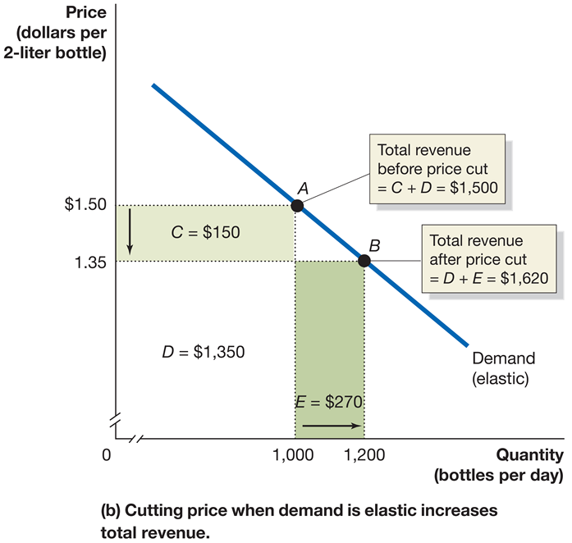
Figure 6.3 The Relationship Between Price Elasticity and Total Revenue (2 of 2)
Revenue before price cut (at A):
Revenue after price cut (at B):
The decrease in price does generates enough extra customers (area E) to more than offset revenue loss (area C).
Notes:
On the truncated graphs, the X axis represents quantity in bottles per day, and the Y axis represents price in dollars per 2 liter bottles. Graph B represents cutting price when demand is elastic increases total revenue. The demand line is elastic, and falls through points A and B. Point A (1,000, 1.50), is the total revenue before price cut = C + D = $1,500. Point B (1,050, 1.35), is the total revenue after price cut = D + E = $1,620. Left of the demand line, Part C = $150, and falls between (0, 1.35), (0, 1.50), (1,000, 1.50), and (1,000, 1.35), and shaded light green. Part D = $1,350, and falls between (0, 0), (0, 1.35), (1,000, 1.35), (1,000, 0). Part E = $270, and falls between (1,000, 0), (1,000, 1.35), (1,200, 1.35), and (1,200, 0), and colored dark green.

Slide 29
Table 6.2 The Relationship Between Price Elasticity and Revenue
If demand is … | then … | because …
elastic | an increase in price reduces revenue | the decrease in quantity demanded is proportionally greater than the increase in price.
elastic | a decrease in price increases revenue | the increase in quantity demanded is proportionally greater than the decrease in price.
inelastic | an increase in price increases revenue | the decrease in quantity demanded is proportionally smaller than the increase in price.
inelastic | a decrease in price reduces revenue | the increase in quantity demanded is proportionally smaller than the decrease in price.
unit elastic | an increase in price does not affect revenue | the decrease in quantity demanded is proportionally the same as the increase in price.
unit elastic | a decrease in price does not affect revenue | the increase in quantity demanded is proportionally the same as the decrease in price.

Slide 30
Why Are Elasticity and Total Revenue Related?
The formula for price elasticity of demand is :
So if this is greater than 1 (in absolute terms) then quantity demanded goes up by a higher percentage than price, raising the revenue.
A special case occurs when price elasticity of demand is −1: the percentage change in quantity demanded equals the percentage change in price so revenue does not change.

Slide 31
Figure 6.4 Elasticity Is Not Constant Along a Linear Demand Curve (1 of 2)
Suppose we have a linear demand curve.
What happens to total revenue as price increases?
Initially, total revenue rises, suggesting demand is inelastic.
But then total revenue starts to fall, suggesting demand is elastic!
Price | Quantity Demanded | Total Revenue
$8 | 0 | $0
7 | 2 | 14
6 | 4 | 24
5 | 6 | 30
4 | 8 | 32
3 | 10 | 30
2 | 12 | 24
1 | 14 | 14
0 | 16 | 0

Slide 32
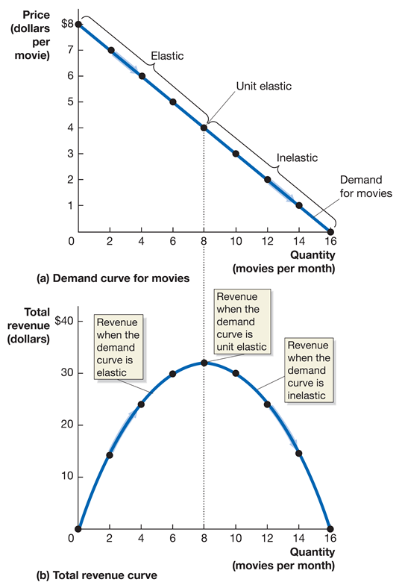
Figure 6.4 Elasticity Is Not Constant Along a Linear Demand Curve (2 of 2)
The data from the table are plotted in the graphs.
As price decreases from $8, revenue rises—hence demand is elastic.
As price continues to fall, revenue eventually flattens out—demand is unit elastic.
Then as price falls even further, revenue begins to fall—demand is inelastic.
Notes:
On both graphs, the X axis represents quantity in movies per month, and the Y axis represents price in dollars per movie. Graph A depicts a demand curve for movies. The demand for movies line falls across the graph through the points
(0, 8)
(2, 7)
(4, 6)
(6, 5)
(8, 4)
(10, 3)
(12, 2)
(14, 1)
(16, 0)
Points between (0, 8) and (8, 0) are elastic. (8, 0) is unit elastic, and points between (8, 0) and (16, 0) is inelastic. Graph B represents the total revenue curve. The demand line arcs through the graph through the points
(0, 0)
(2, 14)
(4, 24)
(6, 30)
(8, 32)
(10, 30)
(12, 24)
(14, 14)
(16, 0)
As the line rises, it is the revenue when the demand curve is elastic. At (8, 32), is when the revenue demand curve is unit elastic. As the line falls, it is the revenue when the demand curve is inelastic.

Slide 33
Apply the Concept: Amazon and Netflix Test the Price Elasticity of Demand for Their Services (1 of 2)
In its early years, Amazon kept the price of Amazon Prime low.
What do you think it have believed about the price elasticity of demand for Amazon Prime?
Recently Amazon has raised the price of Amazon Prime (from $79 to $99 in 2014, and to $119 in 2018).
What does this suggest about how Amazon believed the price elasticity of demand had changed?

Slide 34

Apply the Concept: Amazon and Netflix Test the Price Elasticity of Demand for Their Services (2 of 2)
Do you think the same pattern of elasticity changes has happened with Netflix?
Netflix has raised the price of its two-device plan from $8.99 to $12.99 from 2015-2019. This is consistent with it believing demand has been price inelastic recently.
With more (substitute) streaming options, do you think Netflix will be able to continue raising its price without losing customers?

Slide 35
6.4 Other Demand Elasticities
Define and calculate the cross-price elasticity of demand and the income elasticity of demand and explain their determinants.
When we examined demand in Chapter 3, we discussed substitutes and complements:
Substitutes: Goods and services that can be used for the same purpose.
Complements: Goods and services that are used together.
Cross-price elasticity of demand is the percentage change in the quantity demanded of one good divided by the percentage change in the price of another good.
It measures the strength of substitute or complement relationships between goods.

Slide 36
Table 6.3 Summary of Cross-Price Elasticity of Demand
If the products are … | then the cross-price elasticity of demand will be … | Example
substitutes | positive. | Two brands of smartphones
complements | negative. | iPhones and applications downloaded from online stores
unrelated | zero. | iPhones and peanut butter

Slide 37
Income Elasticity of Demand
When we examined demand in Chapter 3, we discussed normal and inferior goods.
Normal goods: Goods and services for which the quantity demanded increases as income increases
Inferior goods: Goods and services for which the quantity demanded falls as income increases
Income elasticity of demand is a measure of the responsiveness of the quantity demanded to changes in income, measured by the percentage change in the quantity demanded divided by the percentage change in income.

Slide 38
Table 6.4 Summary of Income Elasticity of Demand
If the income elasticity of demand is … | then the good is … | Example
positive but less than 1 | normal and a necessity. | Bread
positive and greater than 1 | normal and a luxury. | Caviar
negative | inferior. | High-fat meat

Slide 39
Apply the Concept: Elasticities of Alcoholic Beverages
Christopher Ruhm of the University of Virginia and colleagues estimated elasticities for various alcoholic beverages. According to their study:
Demand for beer is price inelastic.
Beer and wine are complements.
Beer and spirits are also complements, but the relationship is not as strong.
Beer is a normal good; a necessity.
Are any of these results surprising to you? Why or why not?
Price elasticity of demand for beer | −0.30
Cross-price elasticity of demand between beer and wine | −0.83
Cross-price elasticity of demand between beer and spirits | −0.50
Income elasticity of demand for beer | 0.09

Slide 40
6.5 Using Elasticity to Analyze the Disappearing Family Farm
Use price elasticity and income elasticity to analyze economic issues.
Over the last century farms have become much more efficient at producing food.
This might appear to make farming more profitable, and hence encourage more people into farming.
But the number of people in farming has fallen substantially (>23 million in 1950, <3 million in 2019).
Why have productivity gains in farming led to fewer people choosing to farm?

Slide 41
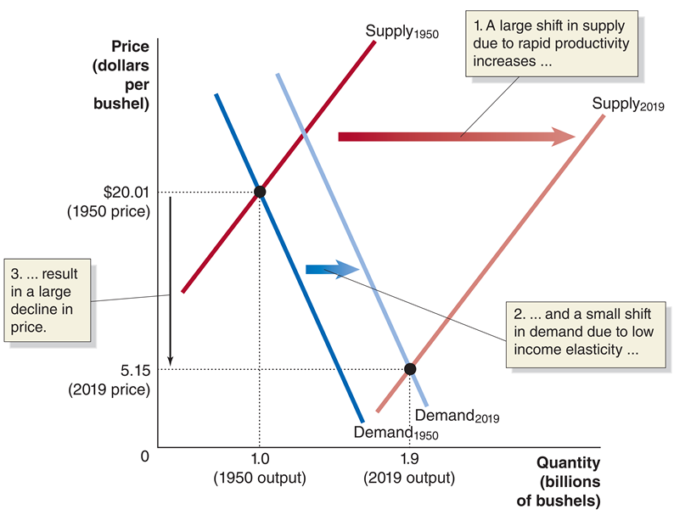
Figure 6.5 Elasticity and the Disappearing Family Farm (1 of 3)
In 1950, U.S. farmers produced 1.0 billion bushels of wheat at a price of $20.01 per bushel.
Over the next seven decades, rapid increases in farm productivity caused a large shift to the right in the supply curve for wheat.
Notes:
The X axis represents quantity in billions of bushels and the Y axis represents price in dollars per bushel. Supply line Supply sub 1950, has a large shift in the supply due to rapid productivity increases, and becomes Supply sub 2019. Demand line Demand sub 1950 falls through the graph, and shifts right. A small shift in demand due to low income elasticity, and becomes Demand sub 2019. Demand sub 1950 intersects Supply sub 1950 at (1, 0 in 1950 output, 20.01 in 1950 price). Demand sub 2019 intersects Supply sub 2019 at (1.9 2019 output, 5.15 2019 price). The span between 20.01 and 5.15 is the result in a large decline in price.

Slide 42
Figure 6.5 Elasticity and the Disappearing Family Farm (2 of 3)
Income elasticity of demand for wheat is low, so demand for wheat increased little over this period.
Demand for wheat is also inelastic, so the large shift in the supply curve and the small shift in the demand curve resulted in a sharp decline in the price of wheat.
Notes:
The X axis represents quantity in billions of bushels and the Y axis represents price in dollars per bushel. Supply line Supply sub 1950, has a large shift in the supply due to rapid productivity increases, and becomes Supply sub 2019. Demand line Demand sub 1950 falls through the graph, and shifts right. A small shift in demand due to low income elasticity, and becomes Demand sub 2019. Demand sub 1950 intersects Supply sub 1950 at (1, 0 in 1950 output, 20.01 in 1950 price). Demand sub 2019 intersects Supply sub 2019 at (1.9 2019 output, 5.15 2019 price). The span between 20.01 and 5.15 is the result in a large decline in price.

Slide 43
Figure 6.5 Elasticity and the Disappearing Family Farm (3 of 3)
In combination, this led to a dramatic fall in the price of the farmers’ output.
Making a living on a small farm has become harder and harder, so the increase in output is supplied by fewer and fewer large-scale farmers.
Notes:
The X axis represents quantity in billions of bushels and the Y axis represents price in dollars per bushel. Supply line Supply sub 1950, has a large shift in the supply due to rapid productivity increases, and becomes Supply sub 2019. Demand line Demand sub 1950 falls through the graph, and shifts right. A small shift in demand due to low income elasticity, and becomes Demand sub 2019. Demand sub 1950 intersects Supply sub 1950 at (1, 0 in 1950 output, 20.01 in 1950 price). Demand sub 2019 intersects Supply sub 2019 at (1.9 2019 output, 5.15 2019 price). The span between 20.01 and 5.15 is the result in a large decline in price.

Slide 44
6.6 The Price Elasticity of Supply and Its Measurement
Define price elasticity of supply and explain its determinants and how it is measured.
Price elasticity of supply is the responsiveness of the quantity supplied to a change in price, measured by dividing the percentage change in the quantity supplied of a product by the percentage change in the product’s price.
It is very much analogous to price elasticity of demand:
So the same sort of calculation methods apply (midpoint formula, etc.).

Slide 45
Determinants of the Price Elasticity of Supply
Price elasticity of supply depends on the ability and willingness of firms to alter the quantity they produce as price increases.
The time period in question is critically important for determining the price elasticity of supply.
Suppose the wholesale price of grapes doubled overnight:
Farmers could do little to increase their quantity immediately; the initial price elasticity of supply would be close to 0.
Over time, farmers could plant more fields in grapes; so over the course of several years, the price elasticity of supply would rise.

Slide 46
Apply the Concept: Why Are Oil Prices So Unstable? (1 of 2)
Oil producers cannot change output very quickly.
When demand increases suddenly, price rises, acting as a rationing mechanism for the increased demand.
Notes:
The truncated X axis represents quantity in millions of barrels per day, and the Y axis represents price in dollars per barrel. Demand line D sub 1 falls through the graph, shifts right, and becomes D sub 2. The supply line rises through the graph, intersecting D sub 1 at (85, 40), and D sub 2 at (89, 110).

Slide 47
Apply the Concept: Why Are Oil Prices So Unstable? (2 of 2)
Similarly, consumers of oil are relatively inflexible, responding little to short-run changes in price.
During the 2010s, new oil production technology known as fracking increased the supply of oil; consequently, the price fell dramatically to maintain equilibrium.
Notes:
The truncated X axis represents quantity in millions of barrels per day, and the Y axis represents price in dollars per barrel. Supply line S sub 1 rises through the graph, shifts right, and becomes S sub 2. The demand line falls through the graph, intersecting S sub 1 at (89, 110), and S sub 2 at (102, 56).

Slide 48
Polar Cases: Perfectly Elastic and Perfectly Inelastic Supply
If a supply curve is a vertical line, we say it is perfectly inelastic.
Quantity supplied is completely unresponsive to price.
Price elasticity of supply equals zero.
Example: Fixed number of spaces in a parking lot.
If a supply curve is a horizontal line, we say it is perfectly elastic.
Supply is infinitely responsive to price.
Price elasticity of supply equals infinity.
Example: Long-run production of agricultural products is (approximately) perfectly elastic: at prices above the cost of production, farmers will supply as much as is demanded.

Slide 49
Table 6.5 Summary of the Price Elasticity of Supply (1 of 5)
Notes:
If supply is elastic, then the value price elasticity is greater than 1. Price versus quantity is plotted.The supply line starts at (0, 1) and rises diagonally to the right through (1000, 1.35) and (1200, 1.5). An arrow extends up from y = 1.35 to y - 1.5. A text inset reads, 1, an 11 percent increase in price. An arrow extends from x = 1000 to x = 1200. A text inset reads, 2, causes an 18 percent increase in quantity supplied.

Slide 50
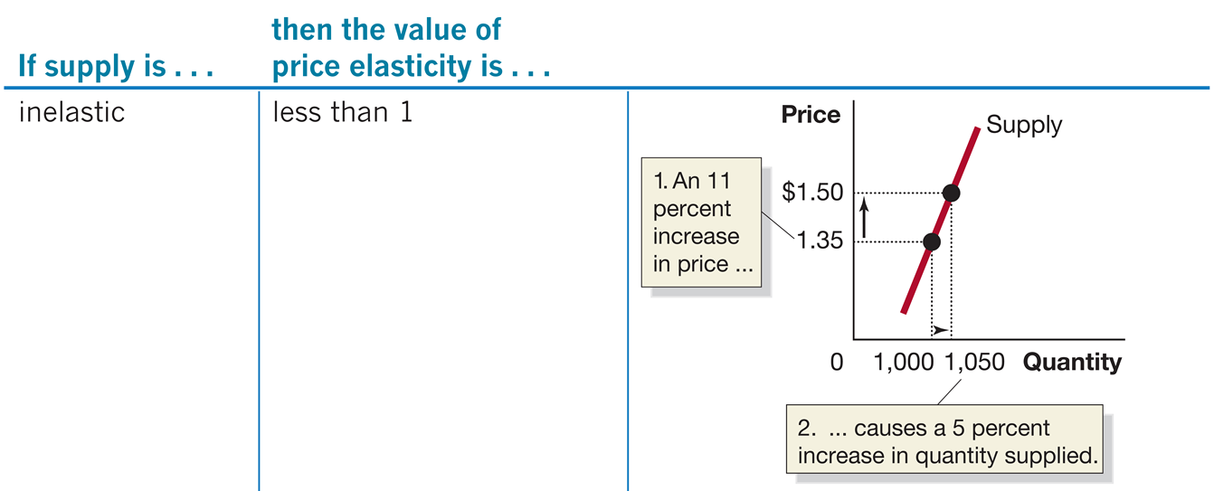
Table 6.5 Summary of the Price Elasticity of Supply (2 of 5)
Notes:
IF supply is inelastic, then the value price elasticity is less than 1. Price versus quantity is plotted. The supply curve rises diagonally from (500, 0.5) to the right through (1000, 1.35) and (1050, 1.50). An arrow extends up from y = 1.35 to y = 1.50. A text inset reads, 1, an 8 percent increase in price. An arrow extends from x = 1000 to x = 1050. A text inset reads, 2, causes a 5 percent increase in quantity supplied.

Slide 51
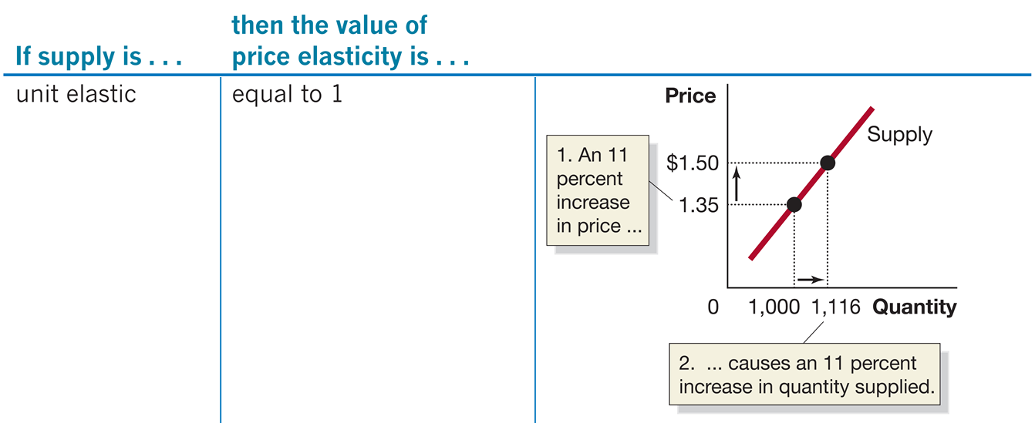
Table 6.5 Summary of the Price Elasticity of Supply (3 of 5)
Notes:
If supply is unit elastic, then the value price elasticity is equal to 1. Price versus quantity is plotted. The supply curve starts at (500, 0.5) and rises diagonally to the right through the points (1000, 1.35) and (1116, 1.5). An arrow points from y = 1.35 to y = 1.5. A text inset reads, 1, an 11 percent increase in price. An arrow extends from x = 1000 to x = 1116. A text inset reads, 2, causes an 11 percent icnrease in quantity supplied.

Slide 52
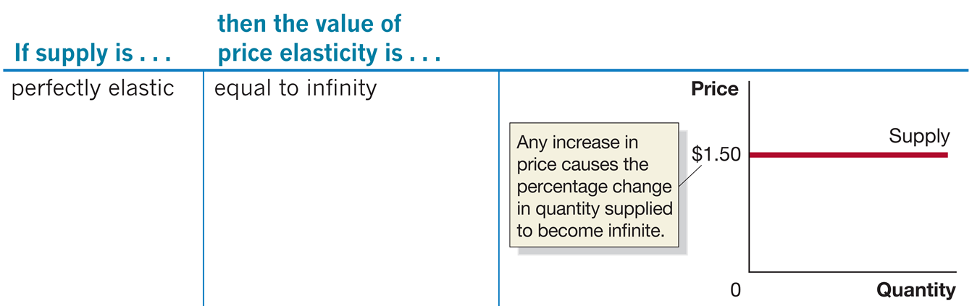
Table 6.5 Summary of the Price Elasticity of Supply (4 of 5)
Notes:
If supply is perfectly elastic, then the value price elasticity is equal to infinity. Price versus quantity is plotted. The supply curve is a horizontal line at y = 1.50. A text inset reads, any increase in price causes the percentage change in quantity supplied to become infinite.

Slide 53
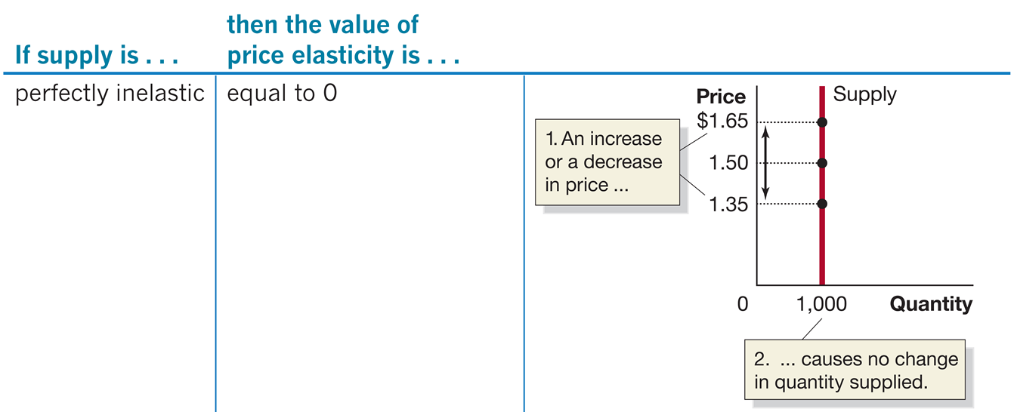
Table 6.5 Summary of the Price Elasticity of Supply (5 of 5)
Notes:
If supply is perfectly inelastic, then the value price elasticity is equal to 0. Quantity is plotted versus price. The supply curve is a vertical line at x = 1000. It passes through y = 1.35, 1.5, and 1.65. A double sided arrow from 1.5 extends up to 1.65 and down to 1.35. A text inset reads, 1, an increase or decrease in price. A second inset at x = 1000 reads, 2, causes no change in quantity supplied.

Slide 54
Why Is Knowing the Price Elasticity of Supply Useful?
Knowing the price elasticity of supply can help us to predict the effect that a change in demand will have:
When demand increases, we know equilibrium price and quantity will increase.
But if supply is inelastic, quantity supplied cannot change much in response to the demand change, so price will rise a lot.
If supply is elastic, price will rise much less.
The next two slides illustrate these statements.

Slide 55
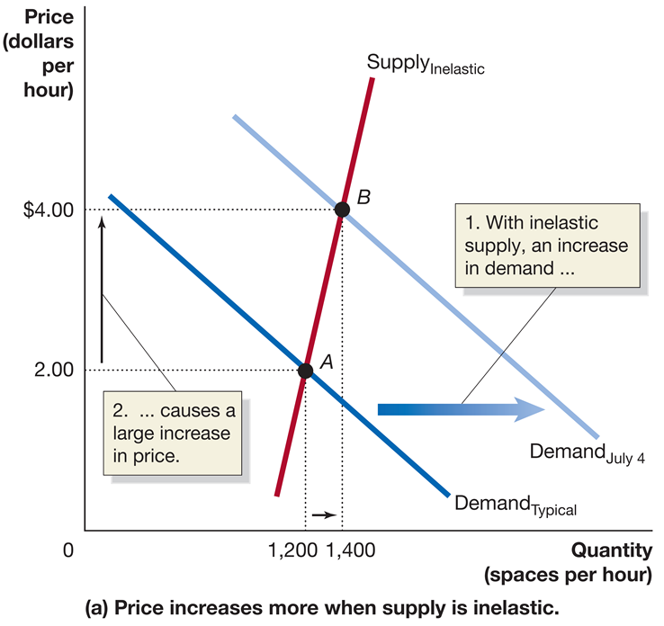
Figure 6.6 Changes in Price Depend on the Price Elasticity of Supply (1 of 2)
Demand _{Typical} represents the typical demand for parking spaces on a summer weekend at a beach resort.
Demand _{July 4} represents demand on the 4th of July.
When supply is inelastic, the price increase will be large.
Notes:
On both graphs, the X axis represents quantity in spaces per hour, and the Y axis represents price in dollars per hour. On graph A, price increases more when supply is inelastic. The demand line demand sub typical shifts right with an inelastic supply, there is an increase in demand, which becomes Demand sub July 4. Supply line Supply sub inelastic rises through the graph, intersecting with demand sub typical at A, (1,200, 2.00), and demand sub July 4 at B, (1,400, 4.00). The distance between 2.00 and 4.00, causes a large increase in price.

Slide 56
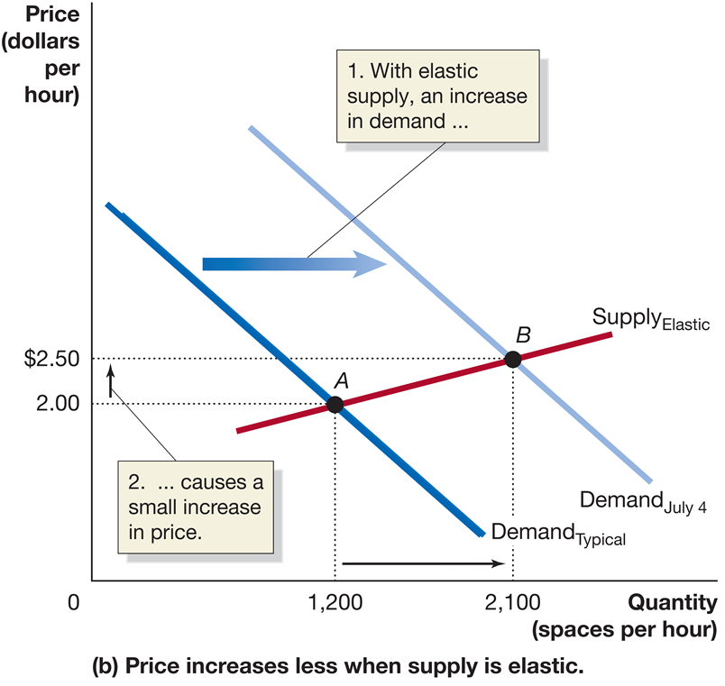
Figure 6.6 Changes in Price Depend on the Price Elasticity of Supply (2 of 2)
If supply is elastic instead, then the resulting price change will be much smaller.
Notes:
On both graphs, the X axis represents quantity in spaces per hour, and the Y axis represents price in dollars per hour. On graph B, price increases less when supply is elastic. Demand line demand sub typical shifts right with elastic supply, there is an increase in demand, and becomes demand sub July 4. The supply line, supply sub elastic intersects demand sub typical at A, (1,200, 2.00), and demand sub July 4 at B, (2,100, 2.50). The distance between 2.00 and 2.50 causes a small increase in price.

Slide 57
Table 6.6 Summary of Elasticities (1 of 3)
Price Elasticity of Demand
Blank | Absolute Value of Price Elasticity | Effect on Total Revenue of an Increase in Price
Elastic | Greater than 1 | Total revenue falls
Inelastic | Less than 1 | Total revenue rises
Unit elastic | Equal to 1 | Total revenue unchanged

Slide 58
Table 6.6 Summary of Elasticities (2 of 3)
Cross-Price Elasticity of Demand
Types of Products | Value of Cross-Price Elasticity
Substitutes | Positive
Complements | Negative
Unrelated | Zero
Income Elasticity of Demand
Types of Products | Value of Income Elasticity
Normal and a necessity | Positive but less than 1
Normal and a luxury | Positive and greater than 1
Inferior | Negative

Slide 59
Table 6.6 Summary of Elasticities (3 of 3)
Price Elasticity of Supply
Blank | Value of Price Elasticity
Elastic | Greater than 1
Inelastic | Less than 1
Unit elastic | Equal to 1

Slide 60

Copyright
This work is protected by United States copyright laws and is provided solely for the use of instructors in teaching their courses and assessing student learning. Dissemination or sale of any part of this work (including on the World Wide Web) will destroy the integrity of the work and is not permitted. The work and materials from it should never be made available to students except by instructors using the accompanying text in their classes. All recipients of this work are expected to abide by these restrictions and to honor the intended pedagogical purposes and the needs of other instructors who rely on these materials.

